Slide 1

DATA SCIENCE

Slide 2
OVERVIEW OF DATA SCIENCE
Data science is an interdisciplinary field that uses scientific methods, processes, algorithms, and systems to extract knowledge and insights from structured and unstructured data. It involves the use of techniques from statistics, data analysis, machine learning, and computer science to extract insights and knowledge from data.
Data science can be applied in a wide range of fields, including business, healthcare, finance, and government, among others. The goal of data science is to turn raw data into actionable insights that can inform decision-making and improve outcomes.
Data science is the study of data. Like biological sciences is a study of biology, physical sciences, it’s the study of physical reactions. Data is real, data has real properties, and we need to study them if we’re going to work on them. Data Science involves data and some signs.

Slide 3
USES OF DATA SCIENCE
Data science is a field that involves using scientific methods, processes, algorithms, and systems to extract knowledge and insights from structured and unstructured data. It can be used in a variety of industries and applications such as:
Business: Data science can be used to analyze customer data, predict market trends, and optimize business operations.
Healthcare: Data science can be used to analyze medical data and identify patterns that can aid in diagnosis, treatment, and drug discovery.
Finance: Data science can be used to identify fraud, analyze financial markets, and make investment decisions.
Social Media: Data science can be used to understand user behavior, recommend content, and identify influencers.
Internet of things: Data science can be used to analyze sensor data from IoT devices and make predictions about equipment failures, traffic patterns, and more.
Natural Language Processing: Data science can be used to make computers understand human language, process large amounts of text or speech data and make predictions.

Slide 4
Applications of Data Science
Following are some of the applications that make use of Data Science for their services:
Internet Search Results (Google)
Recommendation Engine (Spotify)
Intelligent Digital Assistants (Google Assistant)
Autonomous Driving Vehicle (Tesla)
Spam Filter (Gmail)
Abusive Content and Hate Speech Filter (Facebook)
Robotics (Boston Dynamics)

Slide 5
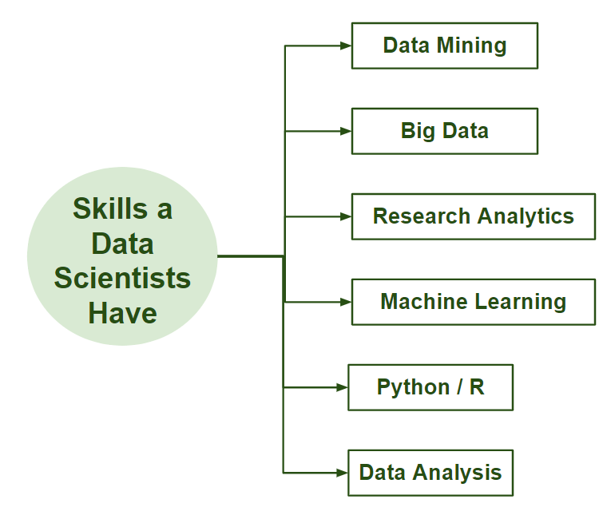

Slide 6
Data Mining
Data mining is the process of discovering patterns, correlations, and insights from large sets of data using statistical, mathematical, and computational techniques. It involves analyzing data from different perspectives and summarizing it into useful information, which can be used to increase revenue, cut costs, or both.
Data Collection: Gather large amounts of data from various sources.
Preprocessing: Clean and organize the data to ensure quality and consistency.
Pattern Discovery: Use algorithms to identify patterns, trends, and relationships in the data.
Evaluation: Assess the discovered patterns for relevance and accuracy.
Knowledge Representation: Present the discovered knowledge in an understandable format, such as graphs or reports.

Slide 7
Common Techniques in Data Mining:
Classification: Assigning items to predefined categories or groups.
Clustering: Grouping similar items together based on their characteristics.
Association Rule Learning: Discovering interesting relationships between variables in large databases.
Regression: Predicting a numeric value based on input data.
Ex.: Market Basket Analysis: Finding associations between products bought together (e.g., customers who buy bread often buy butter).

Slide 8
BIG DATA
Big Data refers to extremely large and complex datasets that are difficult to process and analyze using traditional data processing tools. The term encompasses not only the amount of data but also the diversity, speed, and complexity of the data.
It is an open source and huge volume of data. When we have problem in store and processing that is big data.
Key Characteristics (The 5 V's of Big Data) / Problems
Volume [Huge amount of data]
Velocity [Data Speed in transaction]
Variety [Structured, Un – structured, Semi structured]
Value [Quality]
Veracity [uncertainty and trustworthiness]

Slide 9
SOURCES OF BIG DATA
Social Media: Posts, comments, and interactions.
Internet of Things (IoT): Data from connected devices and sensors.
Transactions: Sales records, financial transactions.
Web Logs: User behavior and interaction logs.
Multimedia: Videos, images, audio files

Slide 10
TECHNOLOGIES FOR BIG DATA
Hadoop: An open-source framework that allows for the distributed processing of large data sets across clusters of computers.
Spark: A fast and general-purpose cluster computing system. It is used only for data processing. I will integrate with any No SQL-DB.
Batch Processing
Stream Processing
NoSQL Databases: Databases like MongoDB and Cassandra designed to handle unstructured data.
Data Lakes: Storage repositories that hold vast amounts of raw data in its native format.

Slide 11
APPLICATIONS:
Business Analytics: Improving decision-making and operational efficiency.
Healthcare: Analyzing patient data for better diagnosis and treatment.
Finance: Detecting fraud and managing risk.
Marketing: Personalizing advertisements and improving customer experiences.

Slide 12
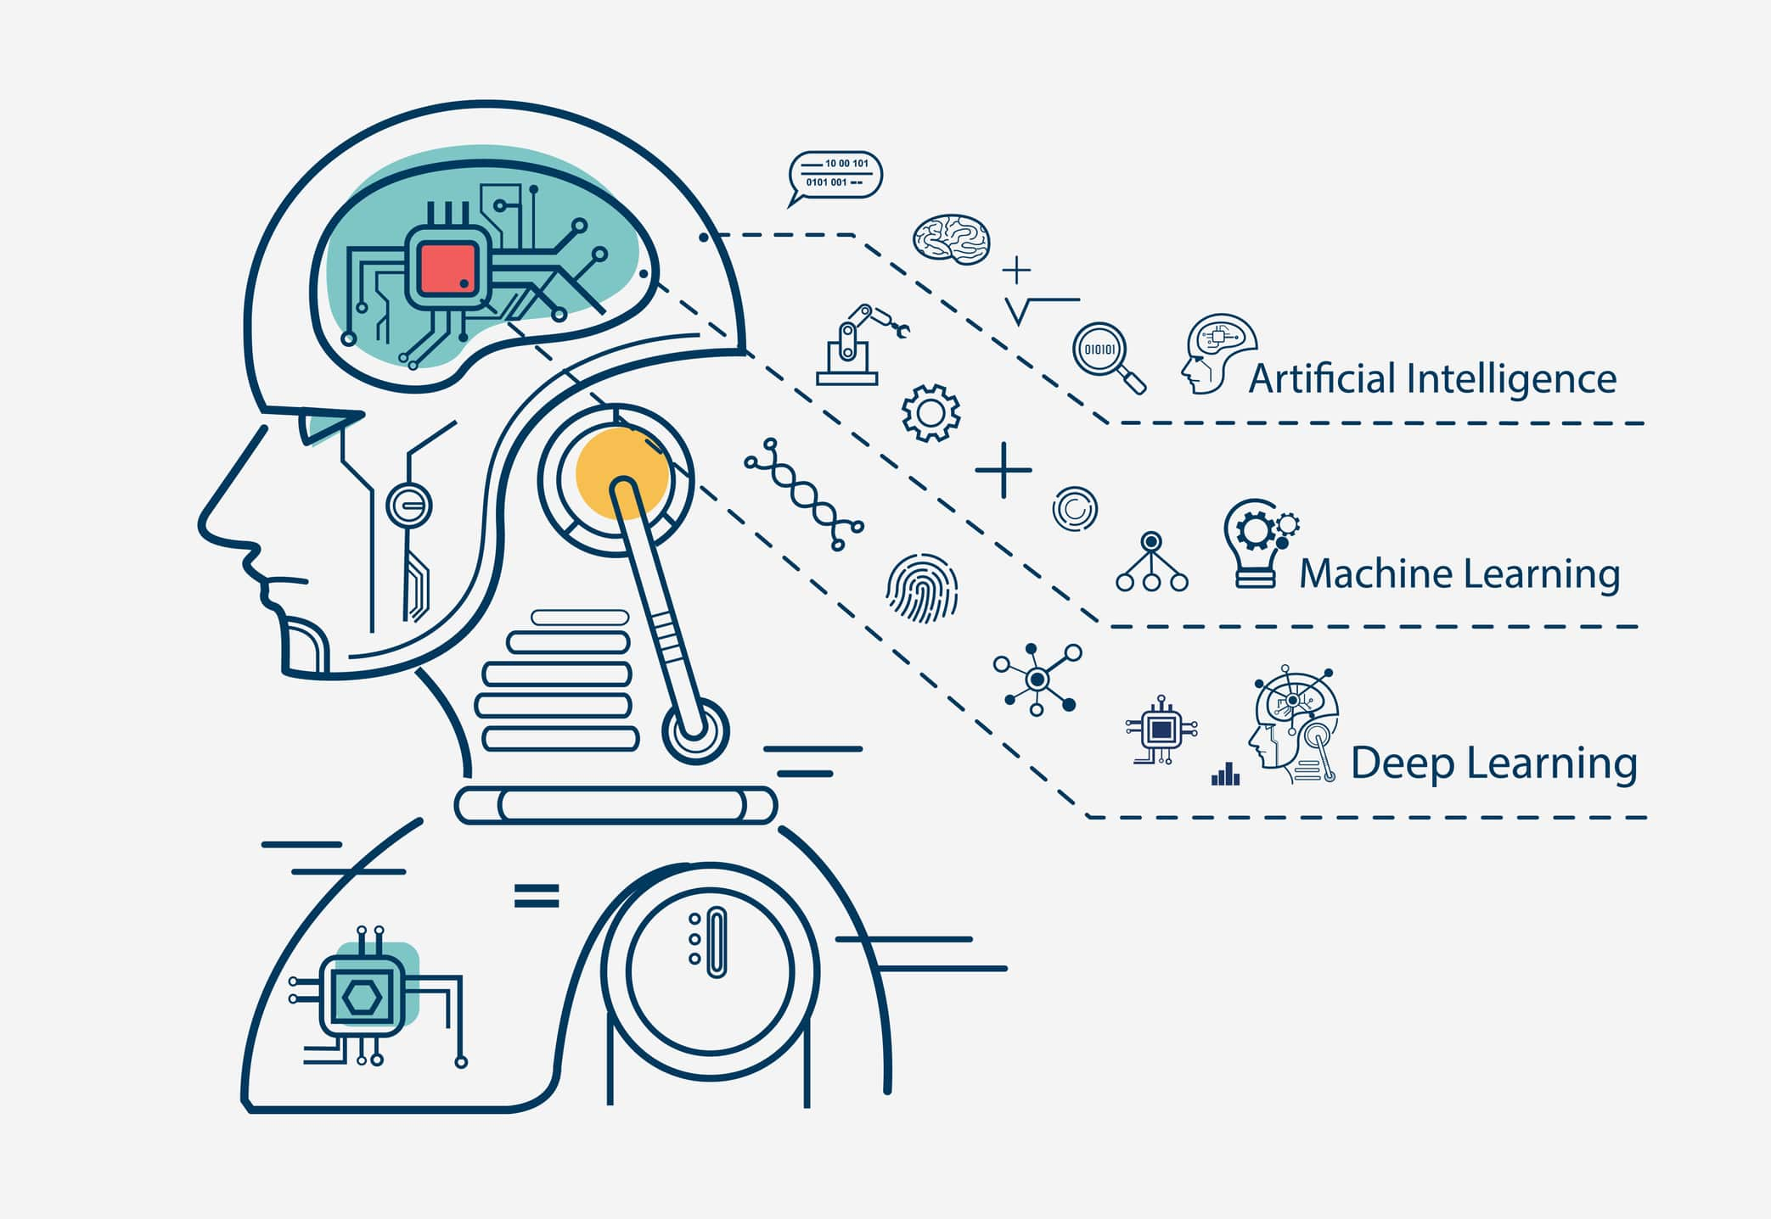

Slide 13
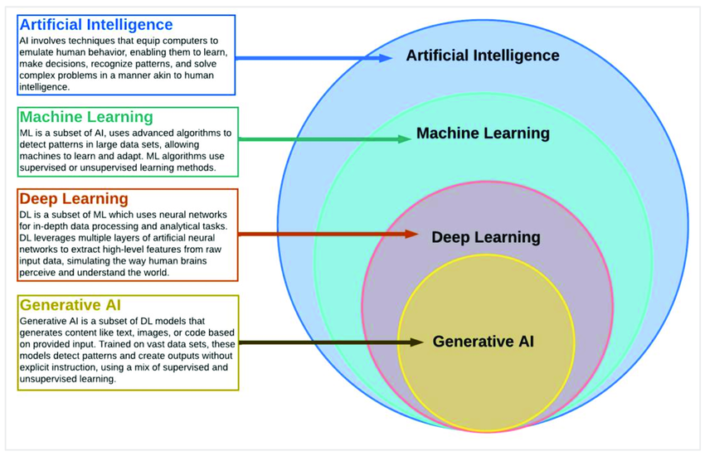

Slide 14
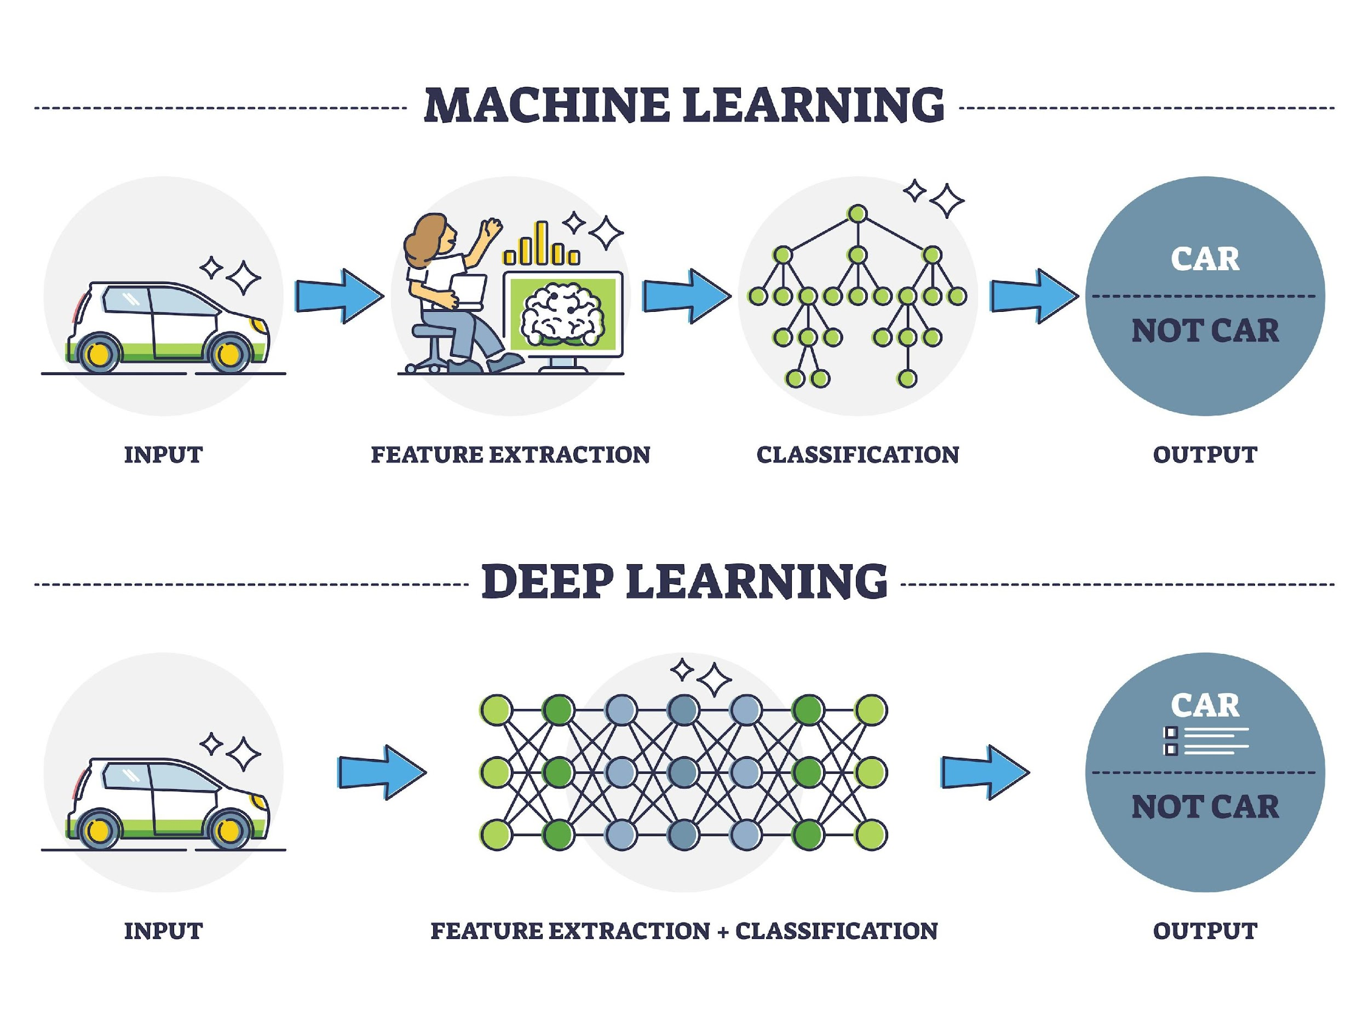

Slide 15
DATA AND CONCEPTS
Analyze, Identify Patterns and Make Decisions
Numerical Data ===🡺 Machine Learning and Deep Learning
Listen and Speak
Text or Audio Data ===🡺 Machine Learning and Natural Language Processing
See and Recognize
Image or Video Data ===🡺 Computer Vision and Deep Learning

Slide 16
STEPS
Gathering Data
Data Preparation
Choosing a model
Training
Evaluation
Parameter Tuning
Prediction

Slide 17
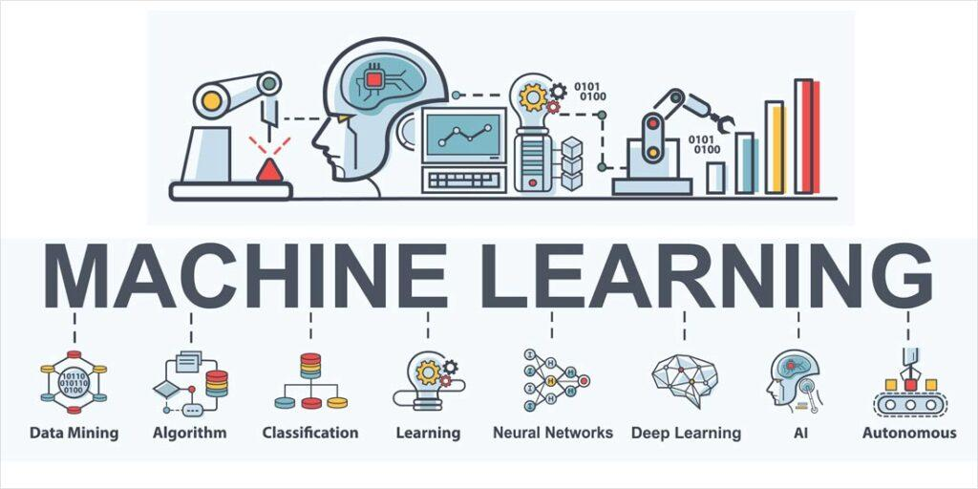

Slide 18
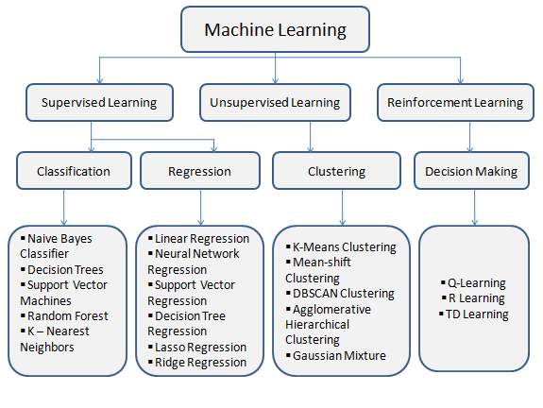
MACHINE LEARNING
ML is a concept where the Machine learns itself from the data with the help of algorithms.
TYPES

Slide 19
SUPERVISED LEARNING:
Definition: A type of machine learning where the model is trained on labeled data. This means that each training example is paired with an output label.
Goal: To learn a mapping from inputs to outputs, enabling the model to predict the label for new, unseen data.
Data: Labeled data (each input comes with a corresponding correct output).
Common Algorithms:
Classification: Logistic Regression, Support Vector Machines (SVM), Decision Trees, Random Forest, Neural Networks.
Regression: Linear Regression, Ridge Regression, Lasso Regression, Support Vector Regression (SVR).
Examples:
Classification: Email spam detection (spam vs. not spam), image recognition (cat vs. dog).
Regression: Predicting house prices based on features like size, location, and number of bedrooms.Key
Advantage: The model learns from clear examples, which typically results in higher accuracy for well-defined tasks.
Key Challenge: Requires a large amount of labeled data, which can be time-consuming and expensive to obtain.

Slide 20
SUPERVISED MACHINE LEARNING
In supervised learning, the machine is trained on a set of labeled data, which means that the input data is paired with the desired output. The machine then learns to predict the output for new input data. Supervised learning is often used for tasks such as classification, regression, and object detection.
Supervised learning, as the name indicates, has the presence of a supervisor as a teacher. Supervised learning is when we teach or train the machine using data that is well-labelled. Which means some data is already tagged with the correct answer. After that, the machine is provided with a new set of examples(data) so that the supervised learning algorithm analyses the training data(set of training examples) and produces a correct outcome from labeled data.
For example, a labeled dataset of images of Elephant, Camel and Cow would have each image tagged with either “Elephant” , “Camel”or “Cow.”

Slide 21
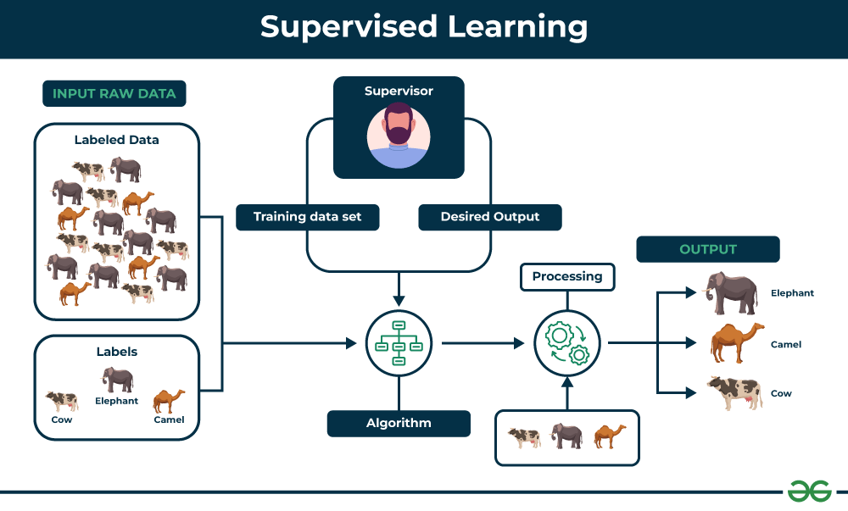

Slide 22
TYPES OF SUPERVISED LEARNING
Supervised learning is classified into two categories of algorithms:
Regression: A regression problem is when the output variable is a real value, such as “dollars” or “weight”.
Classification: A classification problem is when the output variable is a category, such as “Red” or “blue” , “disease” or “no disease”.
Supervised learning deals with or learns with “labeled” data. This implies that some data is already tagged with the correct answer.
Regression
Regression is a type of supervised learning that is used to predict continuous values, such as house prices, stock prices, or customer churn. Regression algorithms learn a function that maps from the input features to the output value.
Some common regression algorithms include:
Linear Regression
Polynomial Regression
Support Vector Machine Regression
Decision Tree Regression
Random Forest Regression

Slide 23
CLASSIFICATION
Classification is a type of supervised learning that is used to predict categorical values, such as whether a customer will churn or not, whether an email is spam or not, or whether a medical image shows a tumor or not. Classification algorithms learn a function that maps from the input features to a probability distribution over the output classes.
Some common classification algorithms include:
Logistic Regression
Support Vector Machines
Decision Trees
Random Forests
Naive Bayes
Evaluating Supervised Learning Models
Evaluating supervised learning models is an important step in ensuring that the model is accurate and generalizable. There are a number of different metrics that can be used to evaluate supervised learning models, but some of the most common ones include

Slide 24
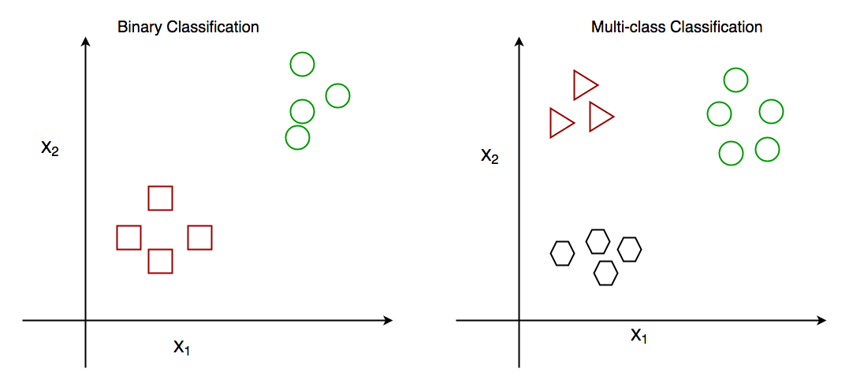
There are two main classification types in machine learning:
Binary Classification
In binary classification, the goal is to classify the input into one of two classes or categories. Example – On the basis of the given health conditions of a person, we have to determine whether the person has a certain disease or not.
Multiclass Classification
In multi-class classification, the goal is to classify the input into one of several classes or categories. For Example – On the basis of data about different species of flowers, we have to determine which specie our observation belongs to.

Slide 25
REGRESSION
Regression is a statistical approach used to analyze the relationship between a dependent variable (target variable) and one or more independent variables (predictor variables). The objective is to determine the most suitable function that characterizes the connection between these variables.
Regression in Machine Learning
It is a supervised machine learning technique, used to predict the value of the dependent variable for new, unseen data. It models the relationship between the input features and the target variable, allowing for the estimation or prediction of numerical values.
Regression analysis problem works with if output variable is a real or continuous value, such as “salary” or “weight”. Many different models can be used, the simplest is the linear regression. It tries to fit data with the best hyper-plane which goes through the points.

Slide 26
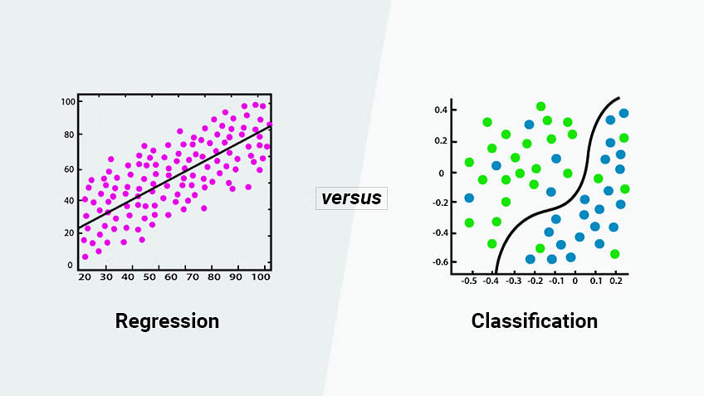

Slide 27
Terminologies Related to the Regression Analysis in Machine Learning
Response Variable: The primary factor to predict or understand in regression, also known as the dependent variable or target variable.
Predictor Variable: Factors influencing the response variable, used to predict its values; also called independent variables.
Outliers: Observations with significantly low or high values compared to others, potentially impacting results and best avoided.
Multicollinearity: High correlation among independent variables, which can complicate the ranking of influential variables.
Underfitting and Overfitting: Overfitting occurs when an algorithm performs well on training but poorly on testing, while underfitting indicates poor performance on both datasets.

Slide 28
CORRELATION
Correlation refers to a statistical relationship between the two entities.
It measures the extent to which the two variables are linearly related.
The value of the correlation always lies between -1 to +1.
Example:
The price and demand of the product is in correlation, they are linearly related.
1. Positive Correlation
2. Negative Correlation
MULTICOLLINEARITY
Multicollinearity occurs in regression analysis when two or more predictor variables (features) are highly correlated with each other. This means that they provide redundant information about the outcome variable (the variable you are trying to predict).

Slide 29
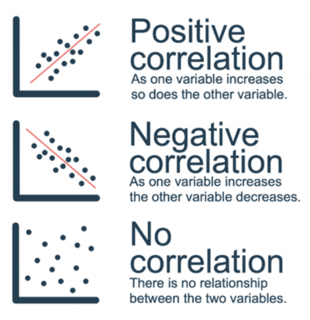
POSITIVE CORRELATION
It means that the linear relationship is positive and the two variables increases or decreases in the same direction.
Ex.: As the No. of trees cut down increases the probability of erosion increases.
NEGATIVE CORRELATION
Negative correlation is just the opposite, the relationship line has a negative slope and the variables change in opposing directions.
Ex.: If a car decreases speed, the time taken to reach the destination increases.

Slide 30
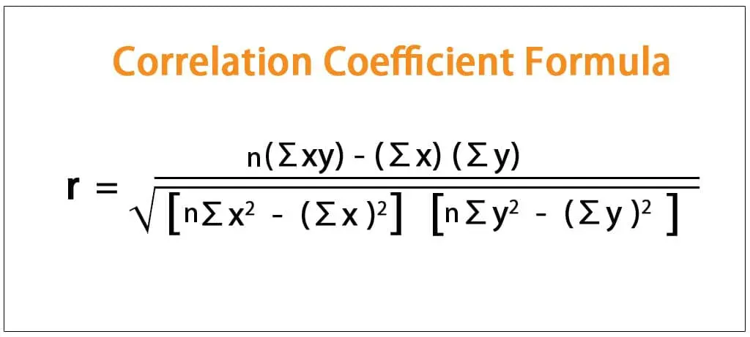
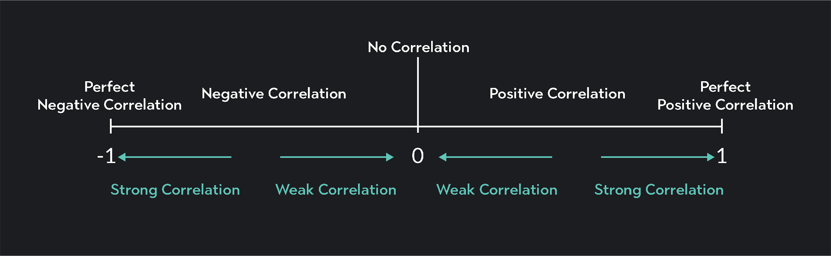
CORRELATION COEFFICIENT
The correlation coefficient is denoted by “r”. It gives as a measure of the strength of the linear relationship between the two variables.

Slide 31
Remove Highly Correlated Predictors: If two variables are highly correlated, consider removing one of them from the model.
Combine Variables: Create a new variable that combines the information from the correlated variables.
Principal Component Analysis (PCA): Use PCA to reduce the dimensionality of the data, which transforms the correlated variables into a set of uncorrelated components.
Regularization: Techniques like Ridge Regression can help mitigate the effects of multicollinearity by adding a penalty to the size of the coefficients.
Summary
Multicollinearity: When predictor variables in a regression model are highly correlated.
Problems: Leads to unstable coefficients, reduced interpretability, and inflated standard errors.
Detection: Use correlation matrices or variance inflation factor VIF.
Solutions: Remove correlated predictors, combine them, use PCA, or apply regularization.

Slide 32
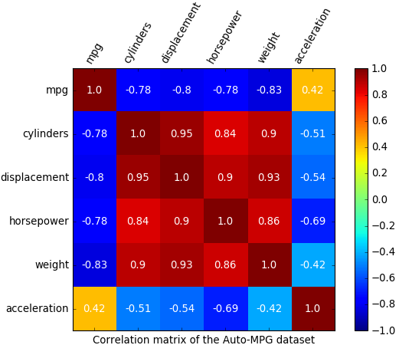

Slide 33
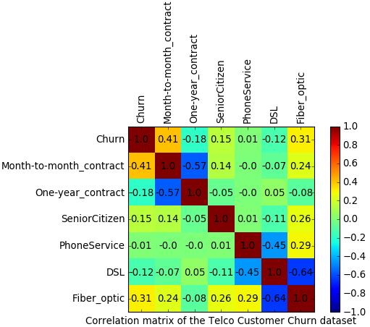

Slide 34
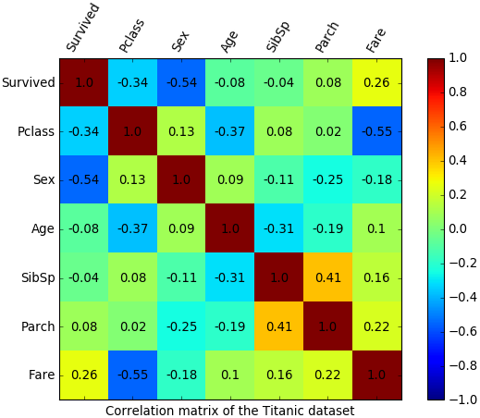

Slide 35
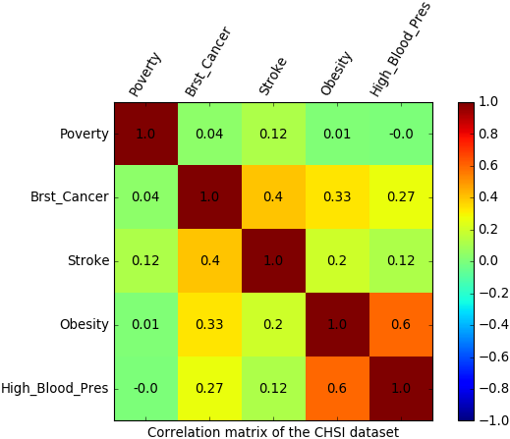

Slide 36
OVERFITTING AND UNDERFITTING
Overfitting and Underfitting are the two main problems that occur in machine learning and degrade the performance of the machine learning models.
The main goal of each machine learning model is to generalize well. Here generalization defines the ability of an ML model to provide a suitable output by adapting the given set of unknown input. It means after providing training on the dataset, it can produce reliable and accurate output. Hence, the underfitting and overfitting are the two terms that need to be checked for the performance of the model and whether the model is generalizing well or not.
Bias: Error in our Training data. Bias is a prediction error that is introduced in the model due to oversimplifying the machine learning algorithms. Or it is the difference between the predicted values and the actual values.
Variance: Error in our Testing data. If the machine learning model performs well with the training dataset, but does not perform well with the test dataset, then variance occurs.

Slide 37
OVERFITTING
Overfitting occurs when our machine learning model tries to cover all the data points or more than the required data points present in the given dataset. Because of this, the model starts caching noise and inaccurate values present in the dataset, and all these factors reduce the efficiency and accuracy of the model. The overfitted model has low bias and high variance.
The chances of occurrence of overfitting increase as much we provide training to our model. It means the more we train our model, the more chances of occurring the overfitted model.
Overfitting is the main problem that occurs in supervised learning.
example: The concept of the overfitting can be understood by the below graph of the linear regression output:

Slide 38
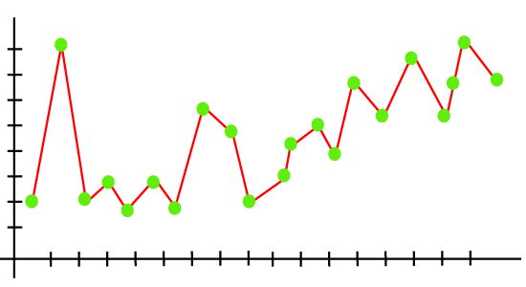
As we can see from the above graph, the model tries to cover all the data points present in the scatter plot. It may look efficient, but in reality, it is not so. Because the goal of the regression model to find the best fit line, but here we have not got any best fit, so, it will generate the prediction errors.

Slide 39
UNDERFITTING 1. Underfitting occurs when our machine learning model is not able to capture the underlying trend of the data. To avoid the overfitting in the model, the fed of training data can be stopped at an early stage, due to which the model may not learn enough from the training data. As a result, it may fail to find the best fit of the dominant trend in the data. 2. In the case of underfitting, the model is not able to learn enough from the training data, and hence it reduces the accuracy and produces unreliable predictions. 3. An underfitted model has high bias and low variance. Example: We can understand the underfitting using below output of the linear regression model:

Slide 40
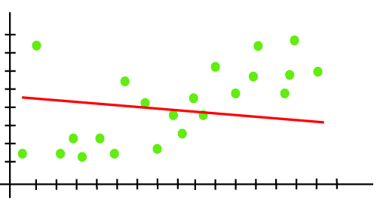
As we can see from the above diagram, the model is unable to capture the data points present in the plot.

Slide 41
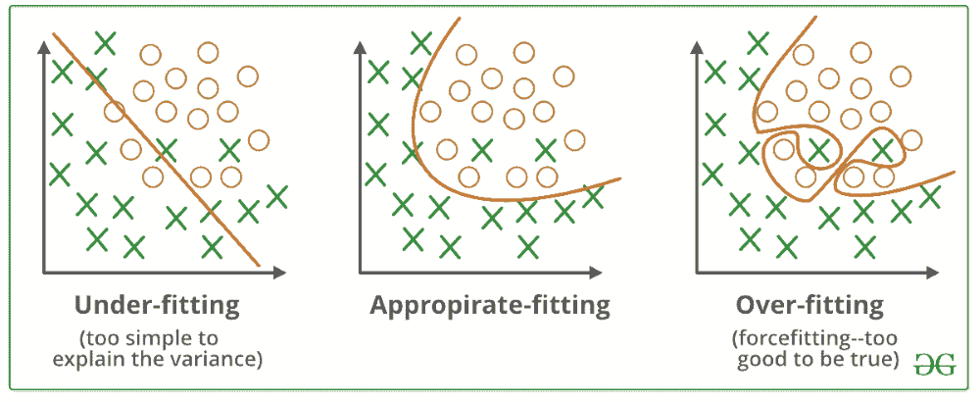

Slide 42
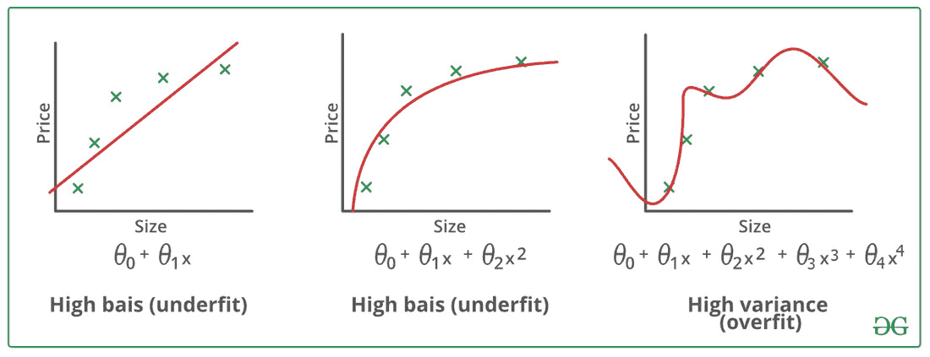

Slide 43
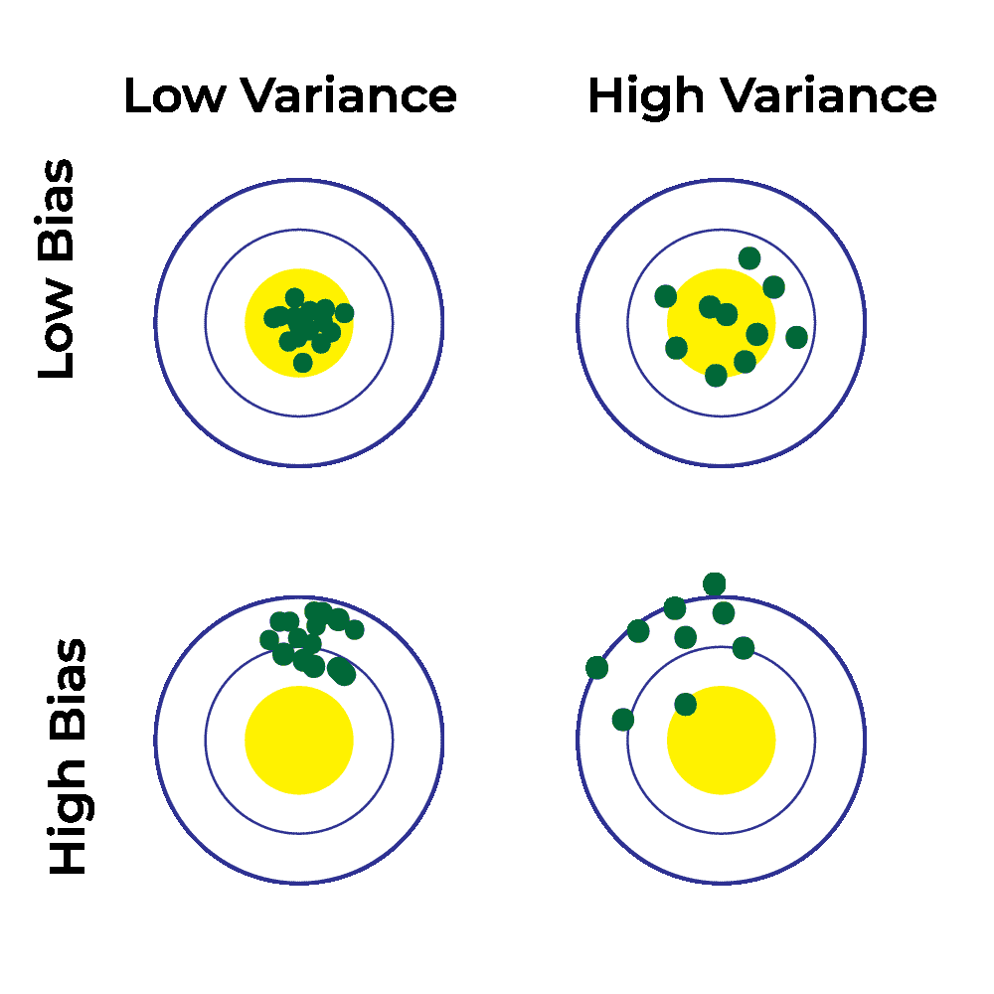
There were four combination between Bias and Variance

Slide 44
✅ 1) First: What is the goal of a ML model?
A machine learning model should:
✅ Learn patterns from training data ✅ Work well on new/unseen data (test data)
That is called Generalization.
✅ 2) Bias vs Variance (Super Easy Meaning)
✅ Bias = “How wrong is the model on average?”
Bias means your model is too simple and keeps making similar mistakes.
📌 Example: Trying to draw a straight line for a curved pattern.
➡️ High Bias = Underfitting
✅ Variance = “How much does the model change if data changes?”
Variance means your model is too sensitive to training data.
📌 Example: If you slightly change training data, the model becomes totally different.
➡️ High Variance = Overfitting

Slide 45
✅ 3) Underfitting vs Overfitting (Simple)
✅ Underfitting (Model is too simple)
Doesn’t learn training data properly
Performs badly on training + test
📌 Example: Predict house price using only 1 rule like: “bigger house = always expensive” (too simple)
✅ Bias: High ✅ Variance: Low ✅ Train error: High ✅ Test error: High
✅ Correct statement:
✅ Underfitting = High Bias + Low Variance ✅

Slide 46
✅ Overfitting (Model is too complex)
Learns training data too perfectly
But fails on test data
📌 Example: Memorizing all answers for an exam but can’t solve new questions.
✅ Bias: Low ✅ Variance: High ✅ Train error: Low ✅ Test error: High
✅ Correct statement:
✅ Overfitting = Low Bias + High Variance ✅

Slide 47
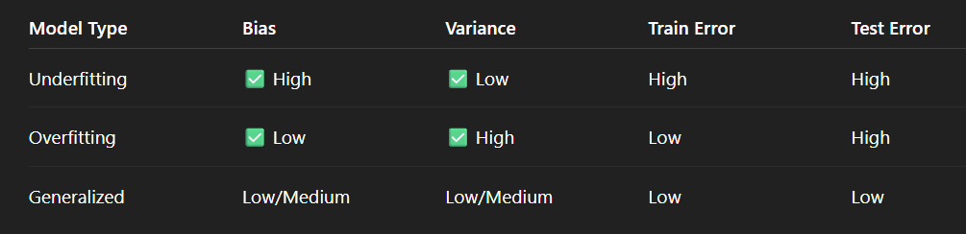
✅ Generalized / Best Fit (Balanced model)
Learns patterns, not noise
Works good on training + test
✅ Bias: Low/Medium ✅ Variance: Low/Medium ✅ Train error: Low ✅ Test error: Low
✅ Correct statement:
✅ Good Fit = Low Bias + Low Variance ✅

Slide 48
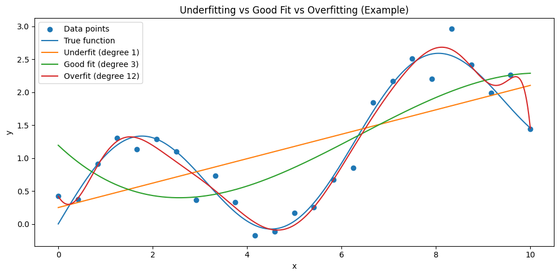
You can see:
Underfit (degree 1 line) → too simple, can’t follow the real curve
Good fit (degree 3) → follows the true pattern smoothly
Overfit (degree 12) → bends too much and tries to match every point (noise also)

Slide 49
“Is there no chance for High Bias + High Variance?”
✅ Yes, it IS possible ✅ (but it’s not the common best-known case)
High Bias + High Variance can happen when:
✅ Case 1: Data is too hard + model is unstable
Example:
Data is highly noisy / random
Features are poor (wrong input data)
Model is not learning real pattern + also keeps changing
So,
Bias high because model can’t capture true pattern
Variance high because model output changes a lot with small data change
📌 Happens in real life when: ✅ very small dataset ✅ too much noise ✅ wrong features ✅ wrong preprocessing ✅ bad hyperparameters (learning rate too high, unstable training)

Slide 50
✅ Case 2: Wrong model for the problem + too flexible
Example:
You choose a model that is “not suitable”
and you also tune it badly (too complex + not generalizing)
✅ Quick summary (final)
✅ Underfitting → High Bias + Low Variance ✅ Overfitting → Low Bias + High Variance ✅ Best / Generalized → Low Bias + Low Variance ✅ Possible worst case → High Bias + High Variance (rare but possible)

Slide 51
✅ If Train = 80% and Test = 75% → is it generalized?
👉 Mostly YES, it looks like a generalized (good fit) model because:
Training accuracy is not too high
Testing accuracy is close to training
Gap = 80 - 75 = 5% (this is a small gap ✅)
✅ Small gap = good generalization ❌ Very big gap = overfitting
✅ How much accuracy is “best fit model”?
There is no fixed number like 90% or 95% for all problems.
✅ Best fit means:
Train accuracy and Test accuracy should be close
Example best-fit patterns:
✅ 80% train, 78% test ✅ 92% train, 90% test ✅ 70% train, 69% test

Slide 52
So “best” depends on:
dataset quality
problem difficulty
noise level
number of classes
business requirement
✅ Simple rule of thumb (easy)
✅ Best fit model usually has:
High test accuracy
Small train-test gap
📌 Gap guidelines (roughly):
0% to 5% gap → Excellent
5% to 10% gap → Acceptable
10%+ gap → likely Overfitting
Both low (ex: 60% train, 58% test) → Underfitting

Slide 53
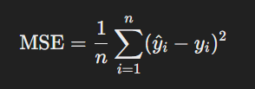
For Regression
Mean Squared Error (MSE): MSE measures the average squared difference between the predicted values and the actual values. Lower MSE values indicate better model performance.
What it measures: MSE calculates the average of the squared difference between the predicted values and the actual values.
How to interpret: A lower MSE indicates that the model’s predictions are closer to the actual values. It penalizes larger errors more because of the squaring.
FORMULA:
where y^i\hat{y}_iy^​i​ is the predicted value, yiy_iyi​ is the actual value, and nnn is the number of observations.

Slide 54

Root Mean Squared Error (RMSE): RMSE is the square root of MSE, representing the standard deviation of the prediction errors. Similar to MSE, lower RMSE values indicate better model performance.
What it measures: RMSE is a square root of the MSE. It provides a measure of the standard deviation of the prediction errors.
How to interpret: Like MSE, a lower RMSE indicates better model performance. It has the same unit as the target variables, making it easier to interpret.
Formula:

Slide 55
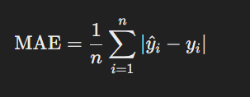
Mean Absolute Error (MAE): MAE measures the average absolute difference between the predicted values and the actual values. It is less sensitive to outliers compared to MSE or RMSE.
What it measures: MAE calculates the average of the absolute differences between the predicted values and the actual values..
How to interpret: A lower MAE indicates better model performance. It is less sensitive to outliers compared to MSE and RMSE because it doesn't square the errors.
Formula:

Slide 56
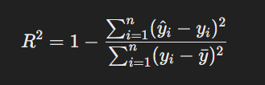
R-squared (Coefficient of Determination): R-squared measures the proportion of the variance in the target variable that is explained by the model. Higher R-squared values indicate better model fit.
What it measures: R-squared indicates the proportion of the variance in the target variable that is explained by the model.
How to interpret: Higher R-squared values (closer to 1) indicate a better fit of the model to the data. It ranges from 0 to 1, where 1 means perfect prediction.
Formula:
where 𝑦ˉyˉ​ is the mean of the actual values.
The proportion of variance in a model, often termed \(R^{2}\) (coefficient of determination) in regression, quantifies how much of the dependent variable's total variability is explained by the independent variables. It represents a "goodness of fit" measure, ranging typically from 0 to 1, where higher values indicate the model explains more data variance.

Slide 57

Classification Evaluation Metrics
Accuracy: Accuracy is the percentage of predictions that the model makes correctly. It is calculated by dividing the number of correct predictions by the total number of predictions.
What it measures: Accuracy tells us how often the model makes correct predictions.
How to interpret: Higher accuracy means the model is performing well overall.
Formula:
Example: If a model makes 80 correct predictions out of 100, the accuracy is 80%.

Slide 58

Precision: Precision is the percentage of positive predictions that the model makes that are actually correct. It is calculated by dividing the number of true positives by the total number of positive predictions.
What it measures: Precision tells us what percentage of positive predictions are actually correct.
How to interpret: Higher precision means the model is good at identifying the positive class without many false positives.
Formula:
Example: If a model predicts 30 positive cases and 25 of them are correct, the precision is 25/30 = 83%.

Slide 59
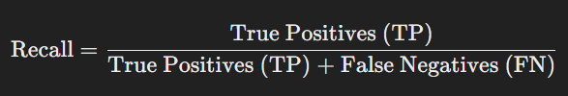
Recall: Recall is the percentage of all positive examples that the model correctly identifies. It is calculated by dividing the number of true positives by the total number of positive examples.
What it measures: Recall tells us what percentage of the actual positive cases the model correctly identifies.
How to interpret: Higher recall means the model is good at finding all the positive cases without many false negatives.
Formula:
Example: If there are 40 actual positive cases and the model correctly identifies 30 of them, the recall is 30/40=75%

Slide 60
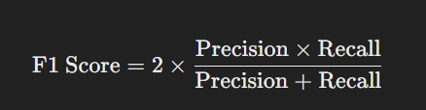

F1 score: The F1 score is a weighted average of precision and recall. It is calculated by taking the harmonic mean of precision and recall.
What it measures: The F1 score is a balance between precision and recall, providing a single metric that considers both.
How to interpret: Higher F1 scores indicate better model performance, especially when there's an imbalance between precision and recall.
Formula:
Example: If a model has a precision of 80% and a recall of 70%, the F1 score is

Slide 61
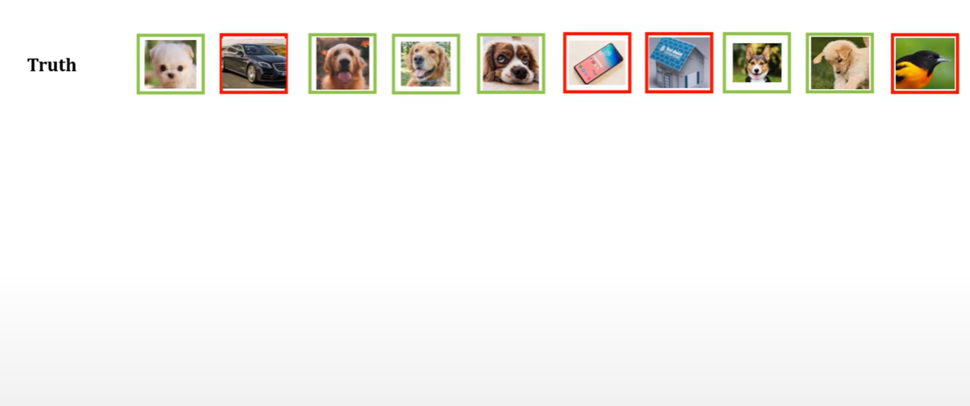

Slide 62
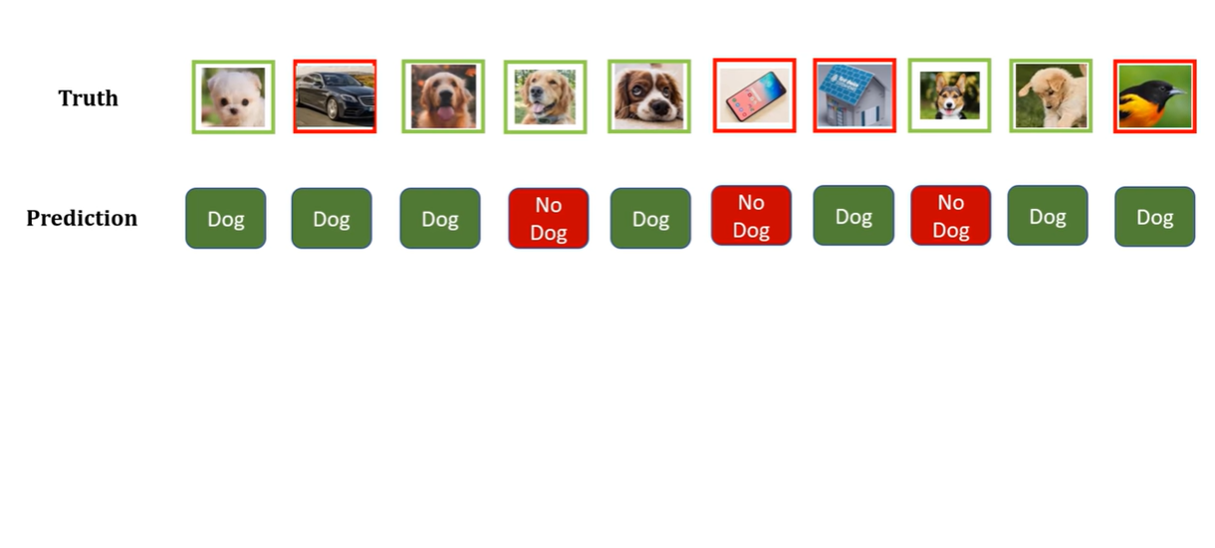

Slide 63
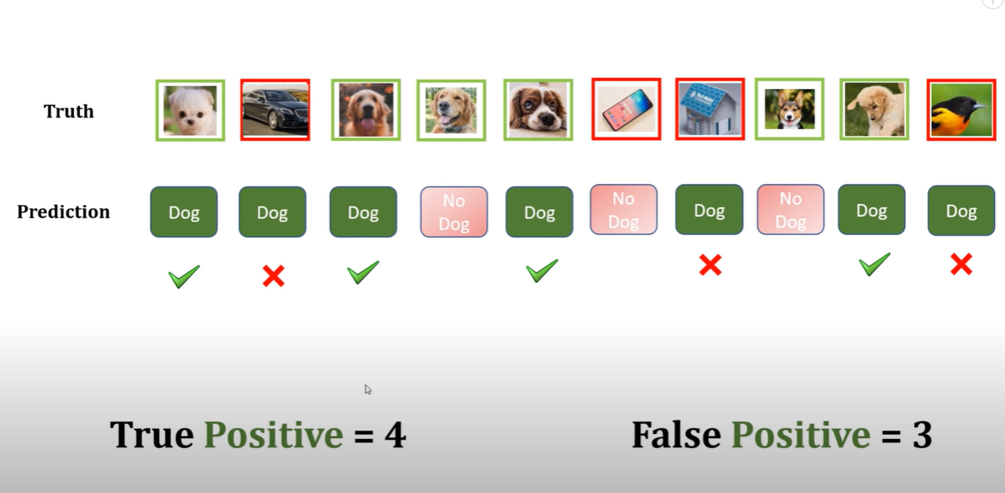

Slide 64
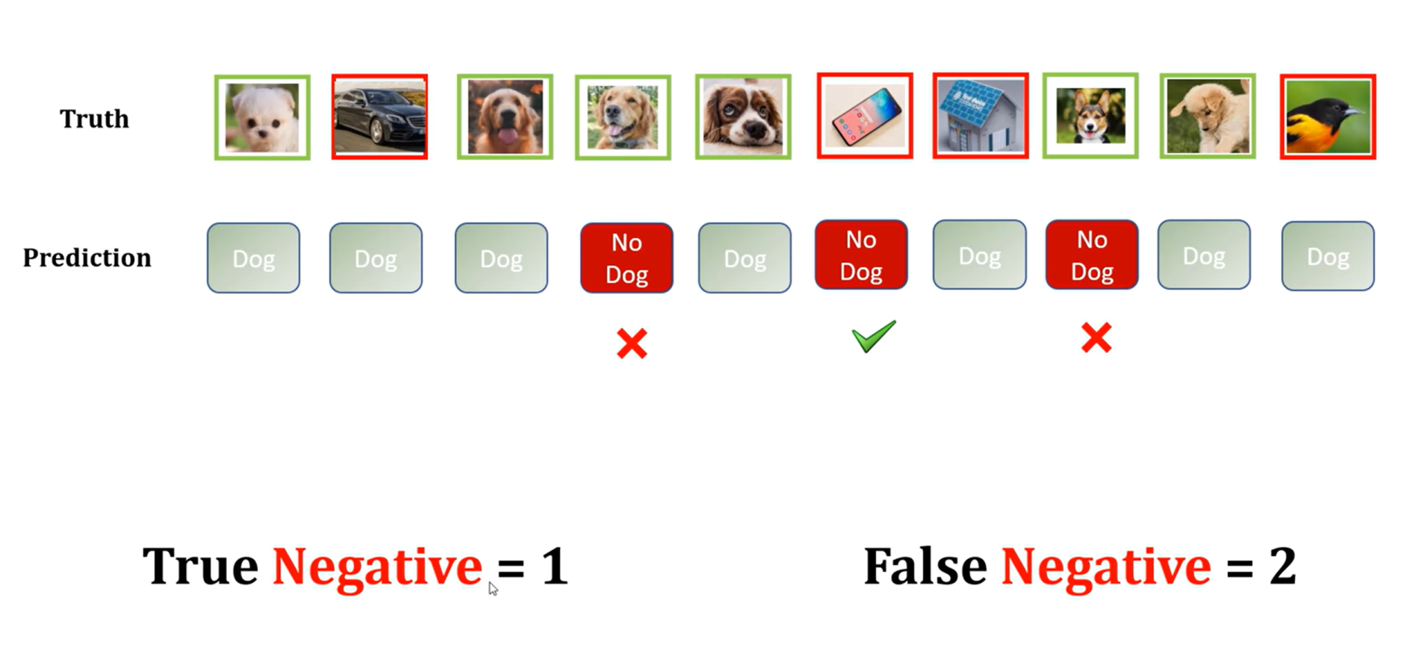

Slide 65
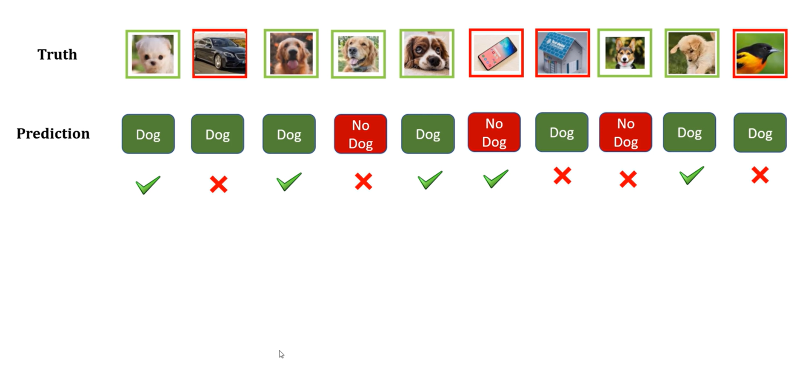

Slide 66
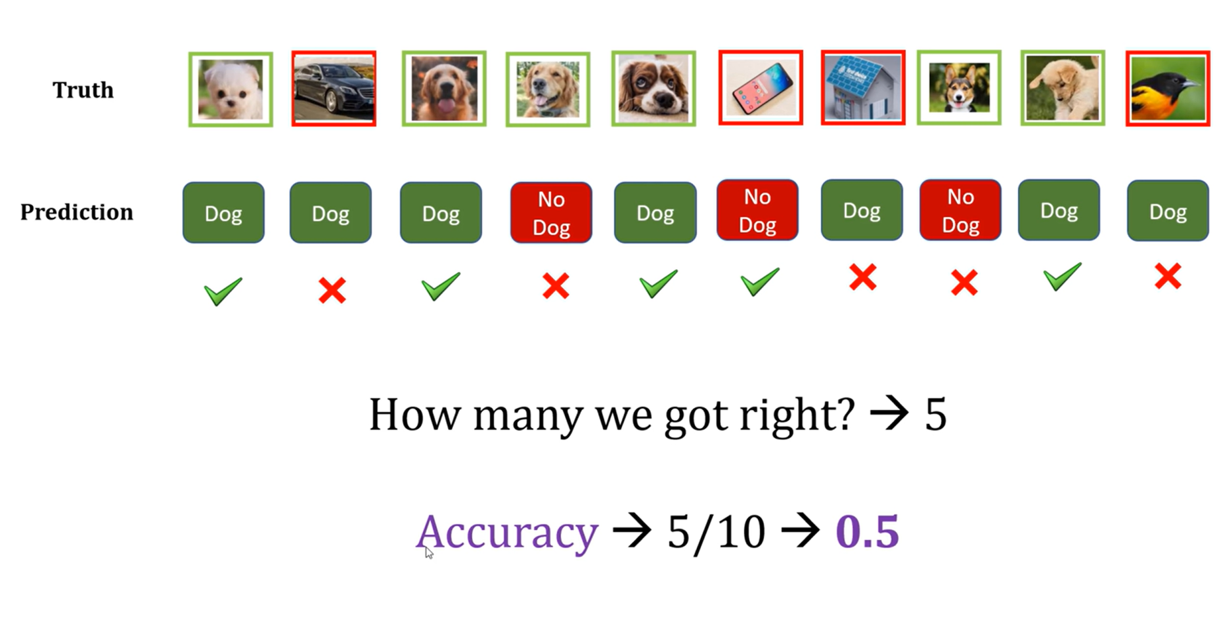

Slide 67
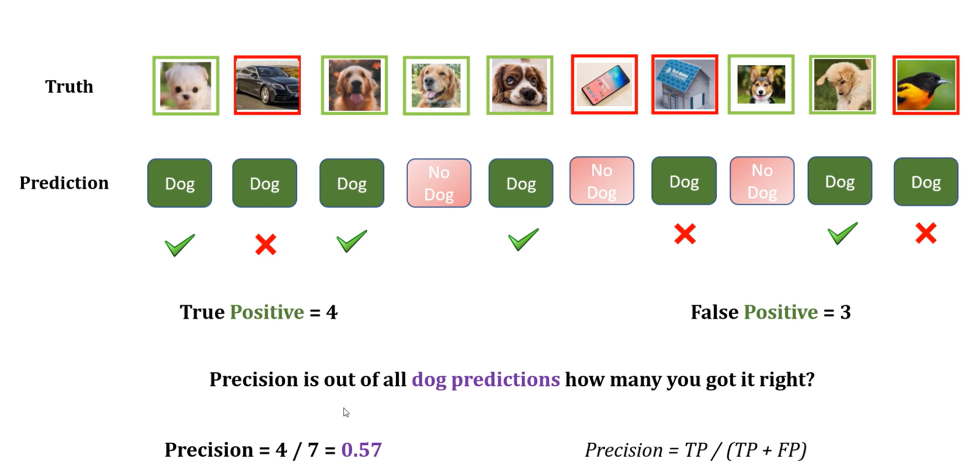

Slide 68
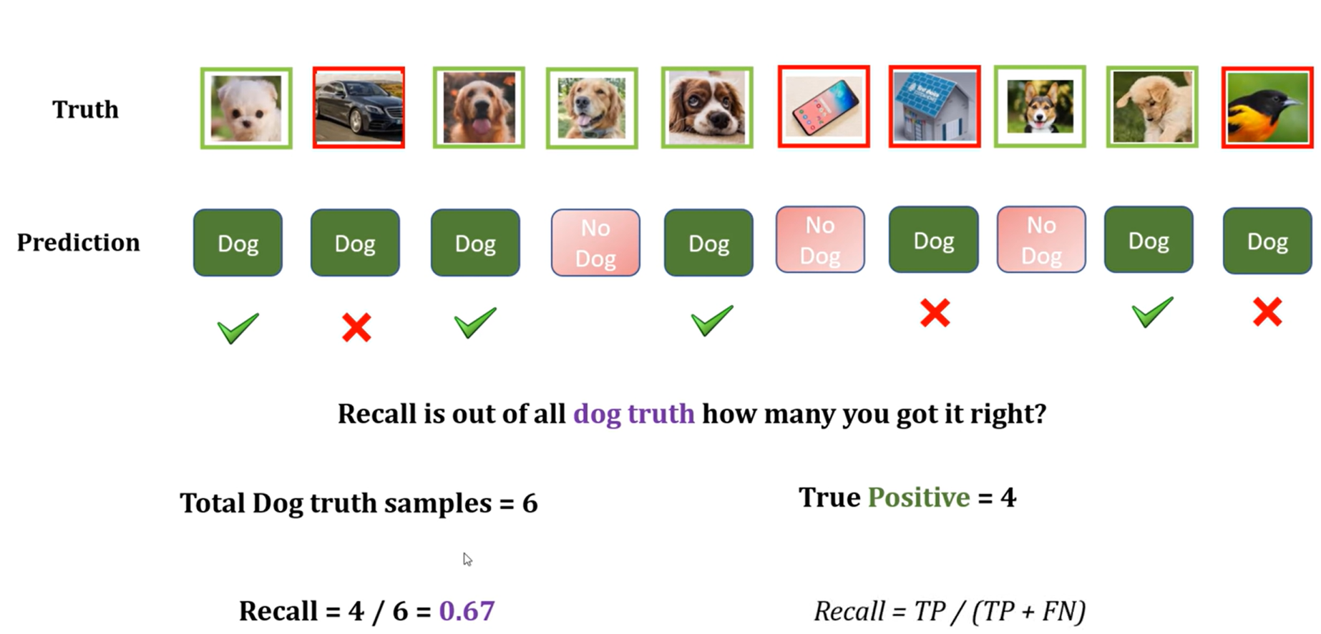

Slide 69
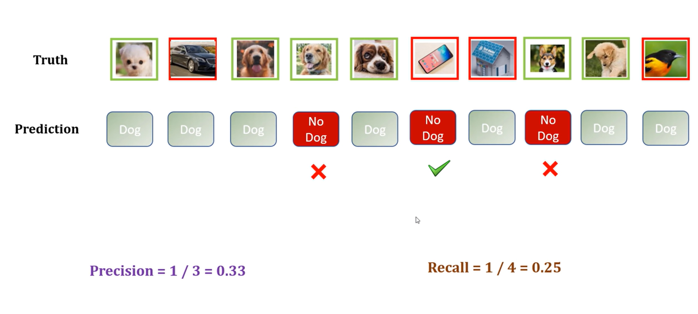

Slide 70
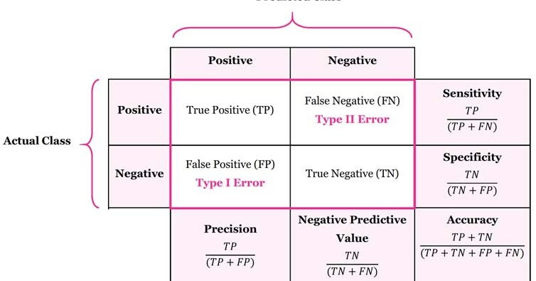
Confusion matrix: A confusion matrix is a table that shows the number of predictions for each class, along with the actual class labels.
What it shows: A confusion matrix is a table that shows the number of true positives, true negatives, false positives, and false negatives.
How to interpret: It helps visualize the performance of the model and identify where it is making mistakes.

Slide 71
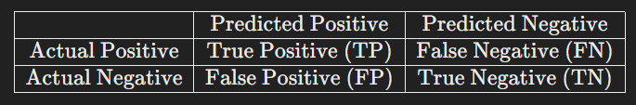
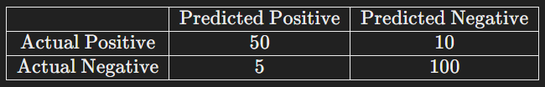
Example: For a binary classification
Example Interpretation: If a confusion matrix has:
True Positives (TP) = 50 : Correctly predicted positives.
False Negatives (FN) = 10 : Actual positives incorrectly predicted as negatives.
False Positives (FP) = 5 : Actual negatives incorrectly predicted as positives.
True Negatives (TN) = 100 : Correctly predicted negatives.

Slide 72
Summary
Accuracy : Overall correctness of the model.
Precision : Correctness of positive predictions.
Recall : Ability to identify all positive cases.
F1 Score : Balance between precision and recall.
Confusion Matrix: Detailed breakdown of correct and incorrect predictions.

